Slide 1

Jobsearch Waterfall Project
Evan Caudy, Gavin Sloan, Jerry Cai, Mana Yamamoto, Thomas Safago

Slide 2

Our Stories

Slide 3
Evan Caudy – Security Lead
Analyzed Security Requirements
Implemented Security, Unit Testing
Made security decisions from design
Implemented functions for safe IO and internal function handling
Implemented unit tests to ensure functionality

Slide 4
Gavin Sloan – Documentation Lead
Managed Physical Documentation
Managed Digital Documentation
Organized binder
Printed all items on the Git repo
Organized git page to requirements
Kept project in scope

Slide 5
Jerry Cai – Programming Lead
Designed Requirements, Diagrams
Implemented Code
Worked with design to incorporate code structure
Formatted and structured primary code diagrams
Wrote and tested implementation
Identified, fixed bugs
Documented daily progress

Slide 6
Mana Yamamoto – Design Lead
Design Project Scope
Designed UI
Created timeline for project
Created milestones for project
Designed a semi friendly UI that fits within the scope
Designed how the front end and the back end will interact with eachother

Slide 7
Thomas Safago – Team Lead
Managed the Kanban
Keeping Track of Progress
Added, assigned, moved tasks
Set milestones
Reviewed issues
Audited issue progress
Notified members of times
Maintained communications

Slide 8
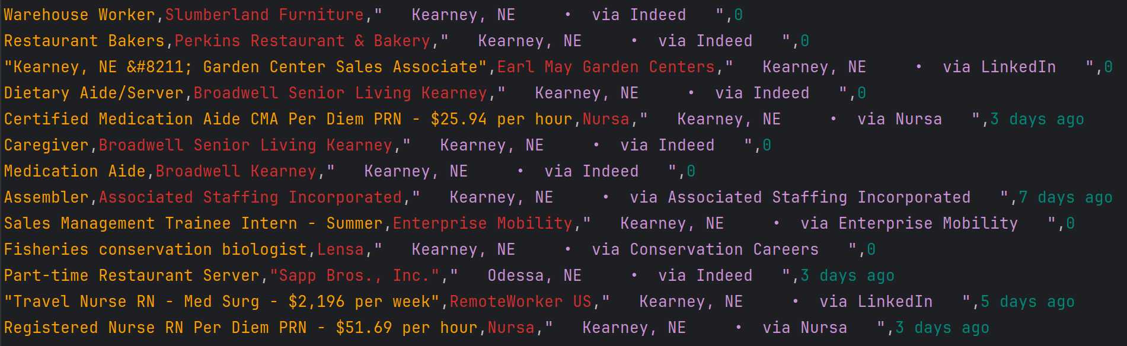
Real Time Demonstration

Slide 9
Thank you everybody!
We have one more video for you...

Slide 10


